Slide 1
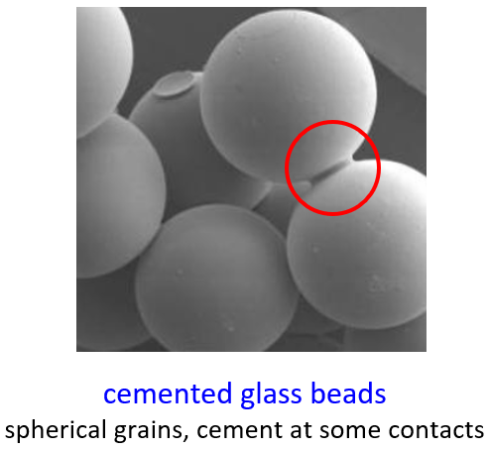
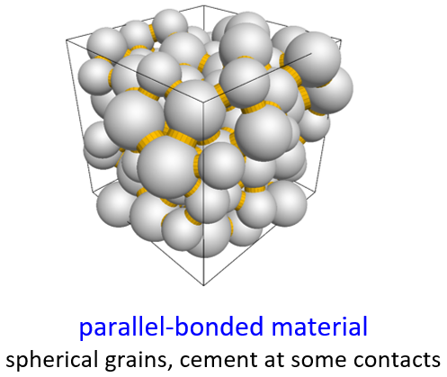
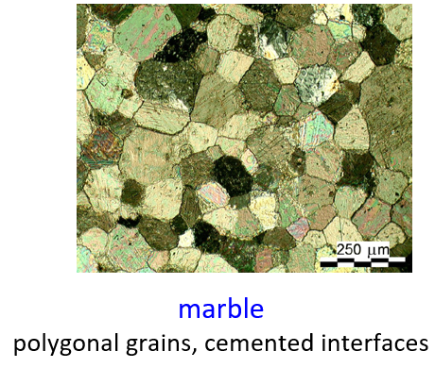
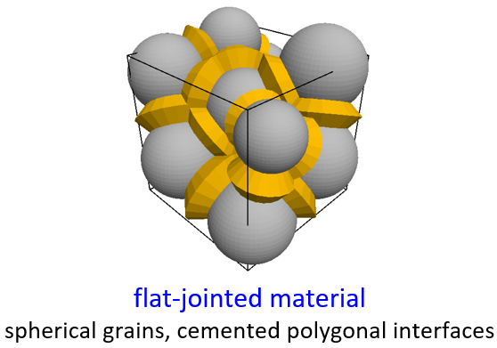
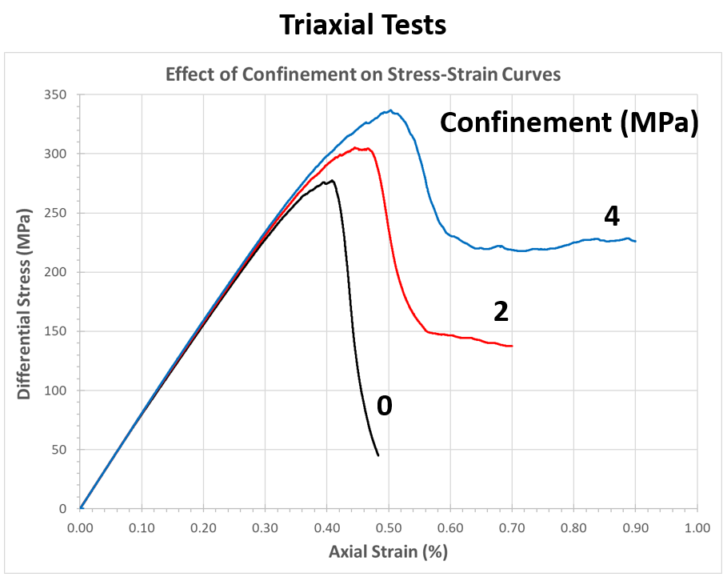
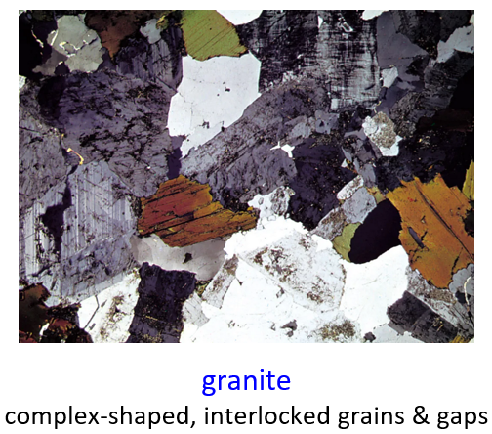
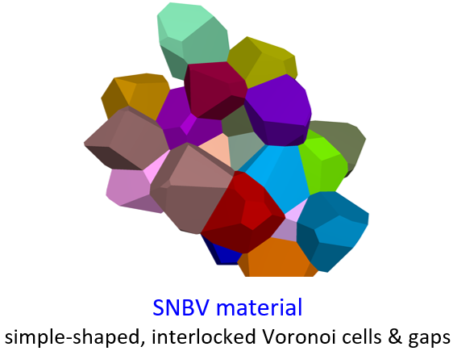
Material Modeling Support for PFC
https://www.itascacg.com/software/material-modeling-support
Triaxial Compression

Slide 2
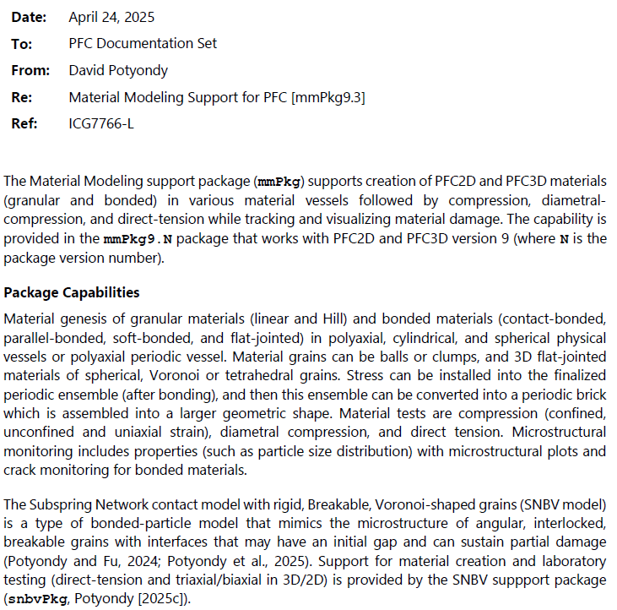

Material Modeling Support for PFC
https://www.itascacg.com/software/material-modeling-support
Bonded Particle Modeling

Slide 3
Microstructural Physics of Rock
Rock is aggregate of crystals & amorphous particles joined by varying amounts of cementing materials
Rock is modeled as heterogeneous material comprised of cemented grains
Microstructural components are at grain-scale
grain size, shape & packing
grain & cement properties (stiffness, strength, degree of cementation)
Each component influences mechanical behavior, and may evolve under load application
0.5 mm
Saint Peter sandstone
grain breakage
cement breakage
grain rearrangement (pore collapse)
load
damage

Slide 4
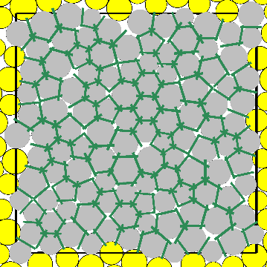
Bonded-Particle Model (constitutive response is emergent)
continuum model
bonded-particle model
elements & nodes
particles & contacts
Enforce continuum behavior constitutive model
(stress-strain curves)
Enforce particulate behavior
contact model
(force-displacement curves)
Explicit microstructure (cemented grains)
grain size, shape & packing
grain & cement properties (stiffness, strength, degree of cementation)
=> constitutive response is emergent

Slide 5
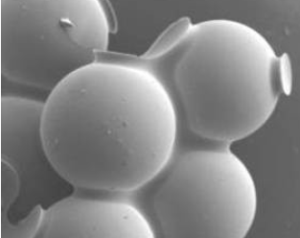
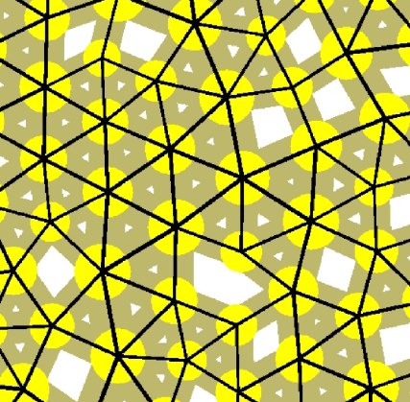
Bonded-Particle Modeling
(What it is)
Bonded-Particle Modeling
(Why it matters)
Rock Mechanics Research & Application
explore relationship between microstructure and macroscopic response
with a focus on damage processes
Glass Beads
cemented with epoxy
Rigid Disks
bonded together
Bonded-Particle Model
Discrete Element Method
Provided in Particle Flow Codes (PFC2D & PFC3D) since 1996
scientific inquiry (understanding)
practical applications. . .

Slide 6
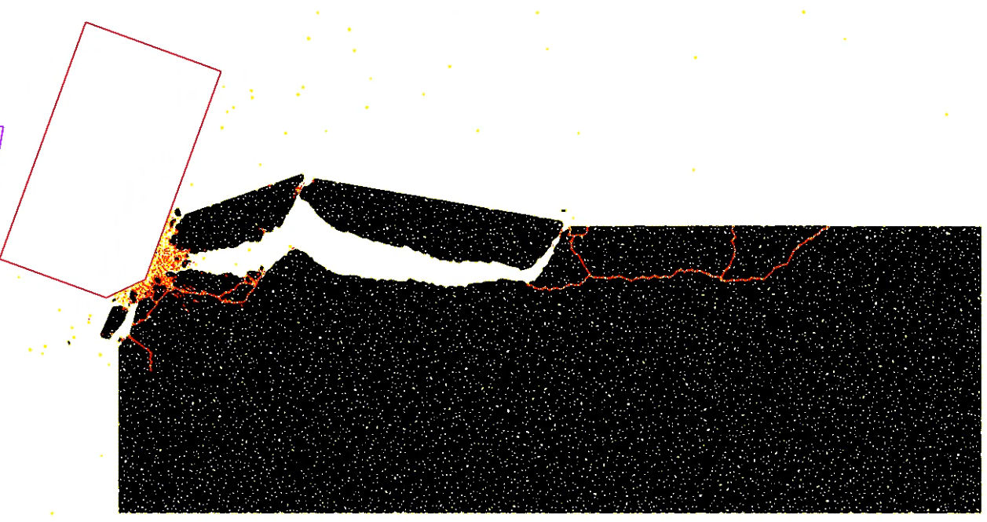
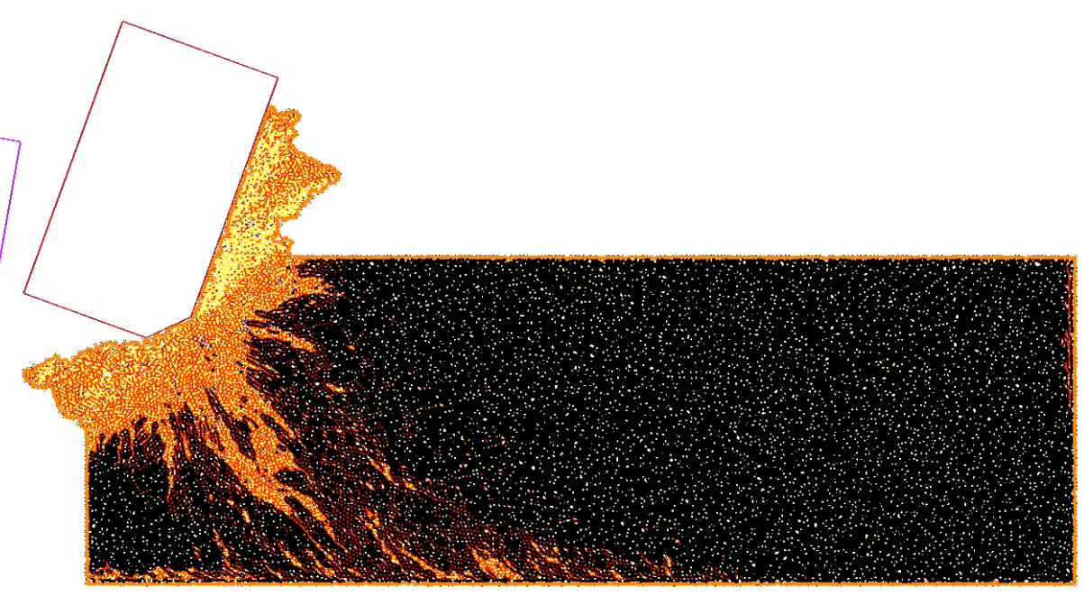
Bonded-Particle Modeling
(What it is)
Rock Cutting (2D)
free surface
brittle
Glass Beads
cemented with epoxy
Rigid Disks
bonded together
confinement from drilling mud
Bonded-Particle Model
Discrete Element Method
Provided in Particle Flow Codes (PFC2D & PFC3D) since 1996
plastic

Slide 7
Rock Cutting with PFC2D
PFC2D model of a rock-cutting test for both dry and wet cutting, during which two cutters are moved across the surface of the synthetic rock, while monitoring forces on the cutters, damage in the rock, and all energy quantities of the cutter-rock system. Wet cutting is modeled by applying a confining pressure to the evolving rock surface via the chaining algorithm. The chaining algorithm repeatedly identifies a connected chain of particles on the rock surface and applies an external force to each of these particles based on the local chain geometry and specified pressure.
Potyondy, D. (2018). Rock-cutting package for PFC2D [rcPkg6.4]. Itasca Consulting Group, Inc., Technical Memorandum 2-5265-01:19TM13 (March 5, 2019).

Slide 8
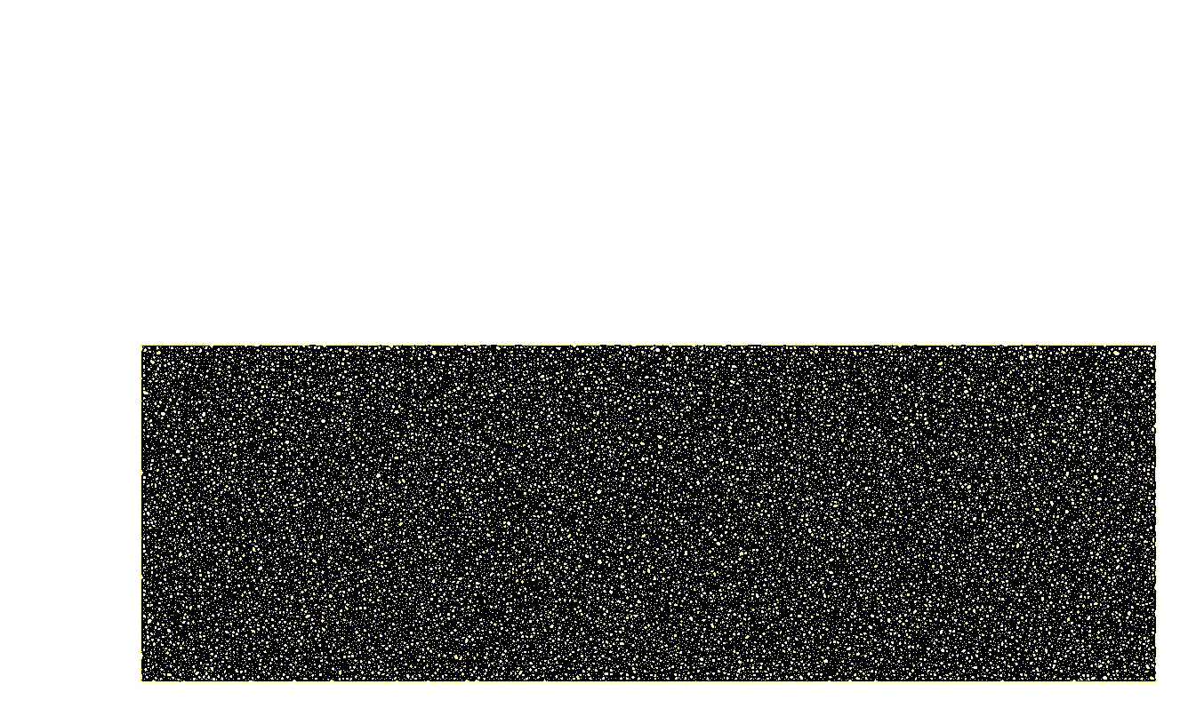
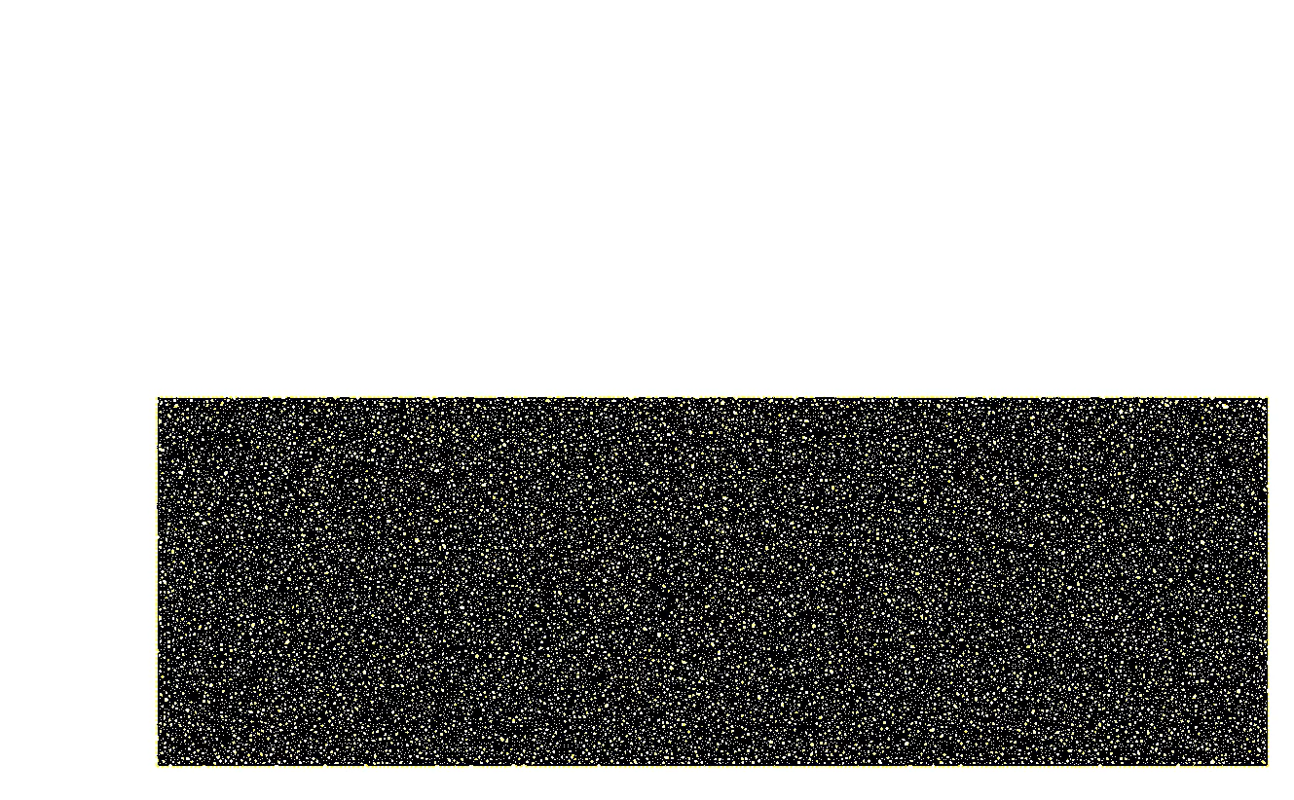
Rock Cutting with PFC2D
free surface
confinement from drilling mud

Slide 9
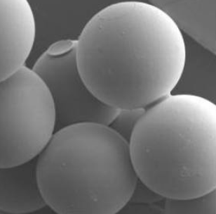
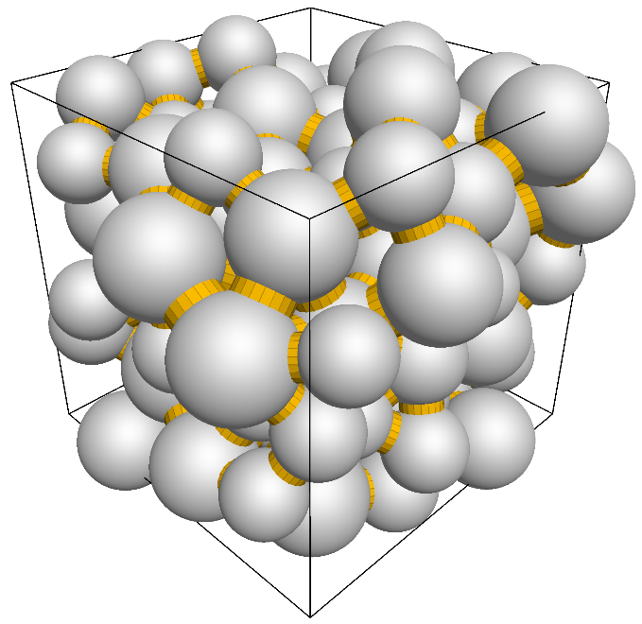
cemented glass beads
spherical grains, cement at some contacts
parallel-bonded material
spherical grains, cement at some contacts
sandstone:
cemented during diagenesis

Slide 10
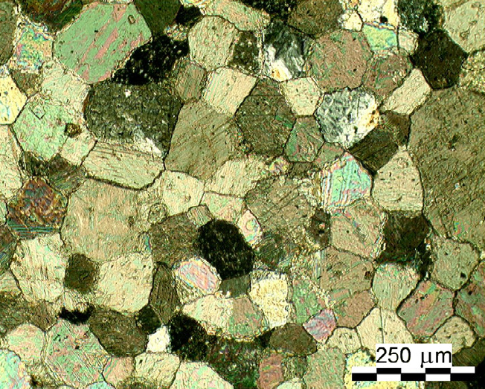
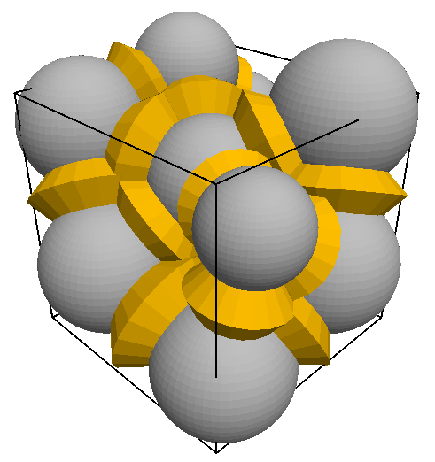
marble
polygonal grains, cemented interfaces
flat-jointed material
spherical grains, cemented polygonal interfaces

Slide 11
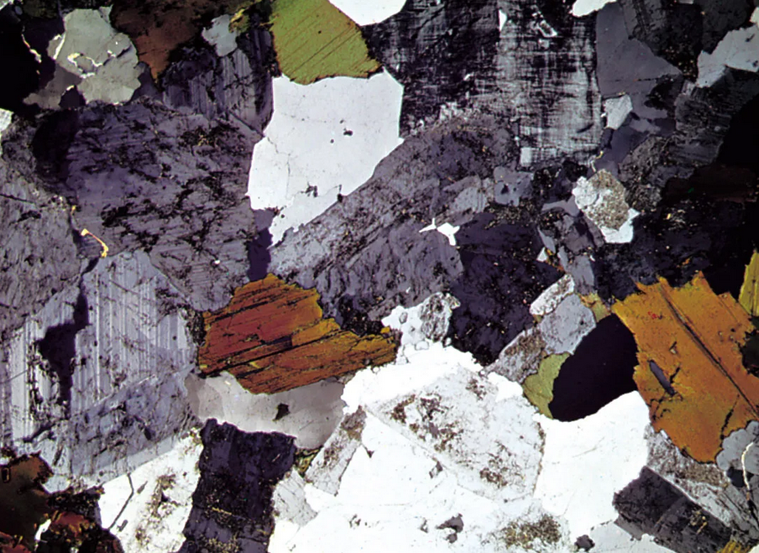
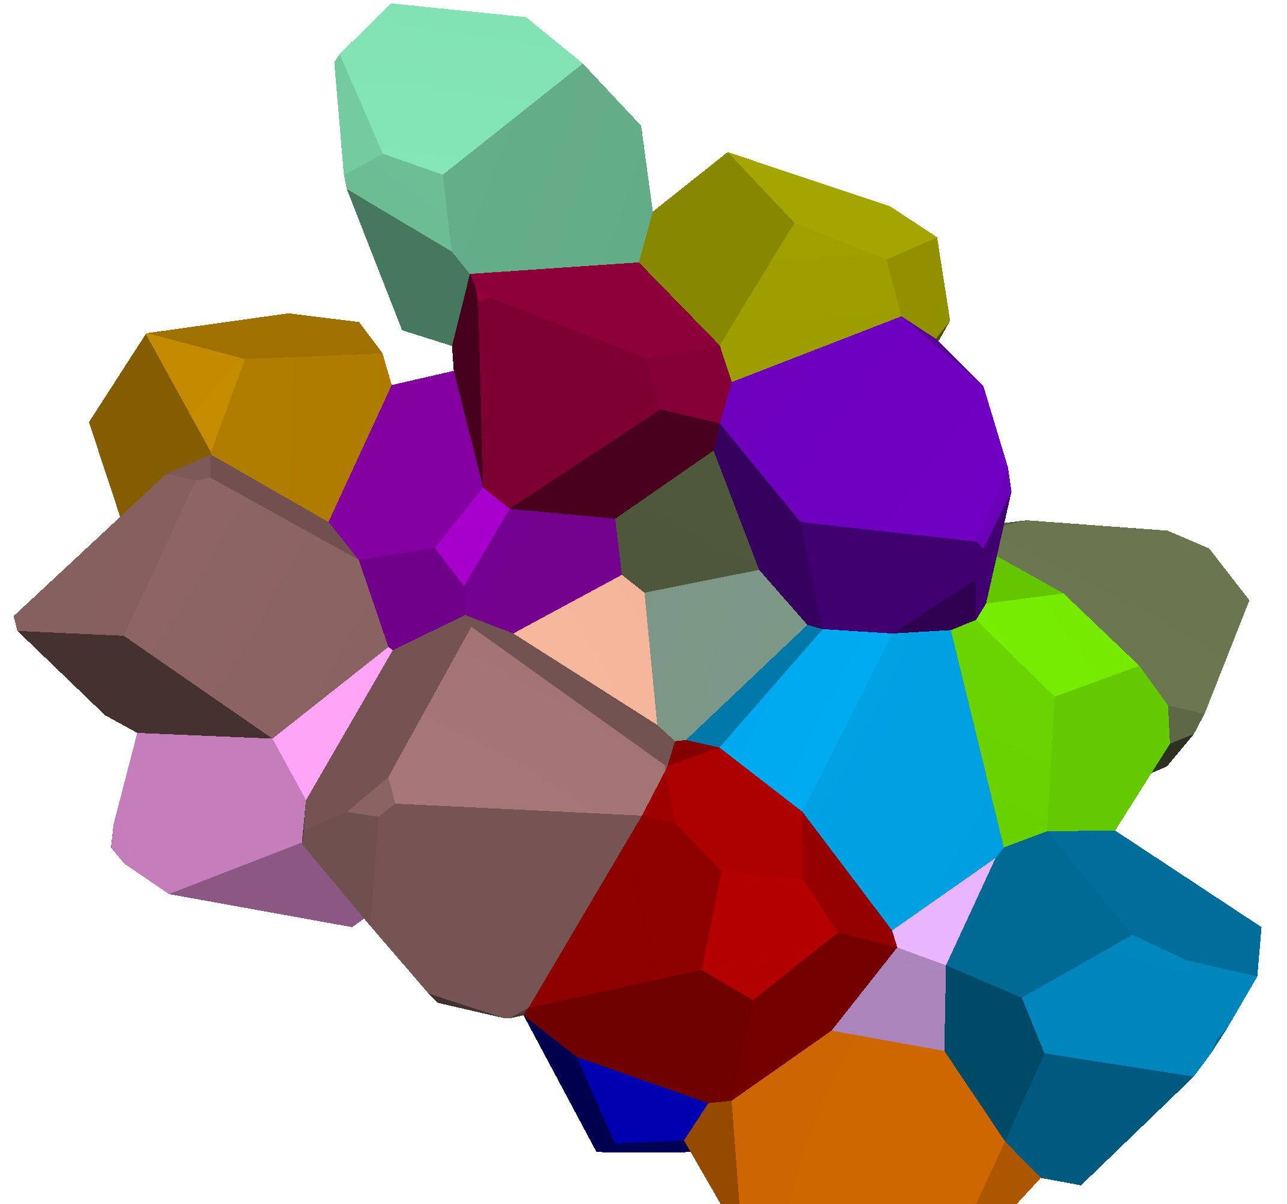
granite
complex-shaped, interlocked grains & gaps
SNBV material
simple-shaped, interlocked Voronoi cells & gaps
igneous rock: crystals form from a melt

Slide 12
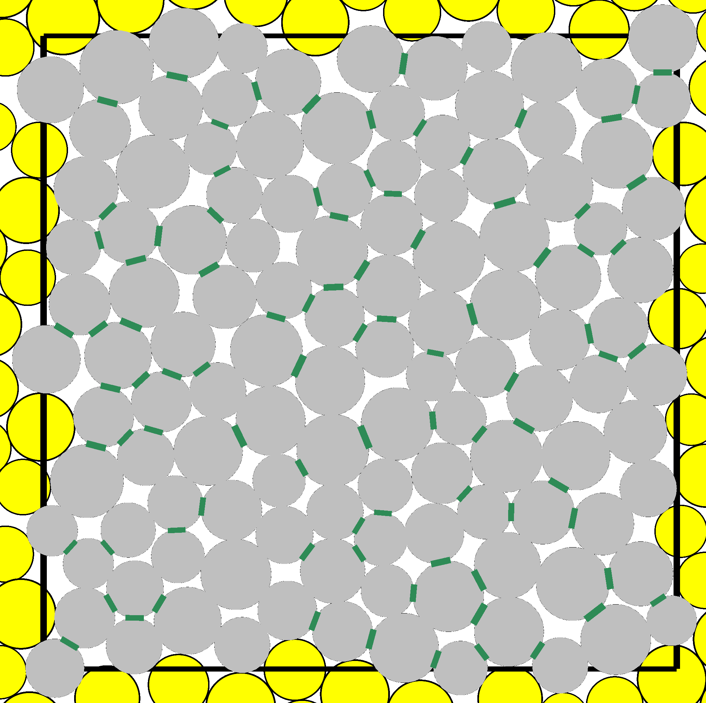
cement
1 mm
biocemented sand
angular grains, cement at some contacts
2D parallel-bonded material
disk-shaped grains, cement at some contacts
synthetic sandstone:
cemented by calcium carbonate

